Slide 6
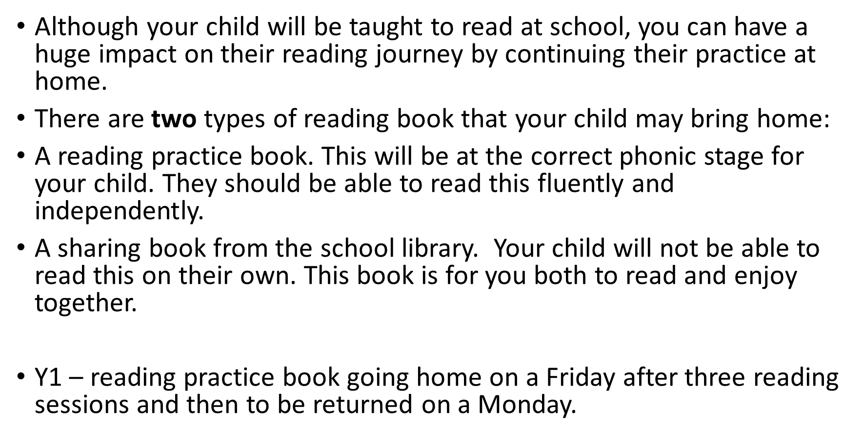

Slide 8
Phonics (free) games
How to play: Change it (youtube.com)
How to play: Mix it up (youtube.com)
How to play: Win it (youtube.com)
PhonicsPlay – Resources
phonics games - Topmarks Search
Online Phonics Games (Phase 3) - PhonicsBloom.com

